Slide 1
MOLECULAR BIOLOGY LABORATORY
BT 453
Laboratory No. 7
Primer Design & SNP Genotyping by RFLP
MBL. BT453

Slide 2
OBJECTIVES
To Know how to design primers for PCR
To know how to genotyping a particular SNP by RFLP
To do what said above by yourself !!!!
MBL. BT453

Slide 3
Important websites
NCBI (National Center for Biotechnology Information)
www.ncbi.nlm.nih.gov
Primer3
http://frodo.wi.mit.edu/primer3
Database of single nucleotide polymorphism (dbSNP)
http://www.ncbi.nlm.nih.gov/snp
UCSC Genome Brower
http://genome.ucsc.edu/cgi-bin/hgPcr?command=start
NEBcutter (New England Biolabs)
http://tools.neb.com/NEBcutter2
Ensemble Genome Browser
http://www.ensembl.org

Slide 4
How To Design Primers

Slide 5
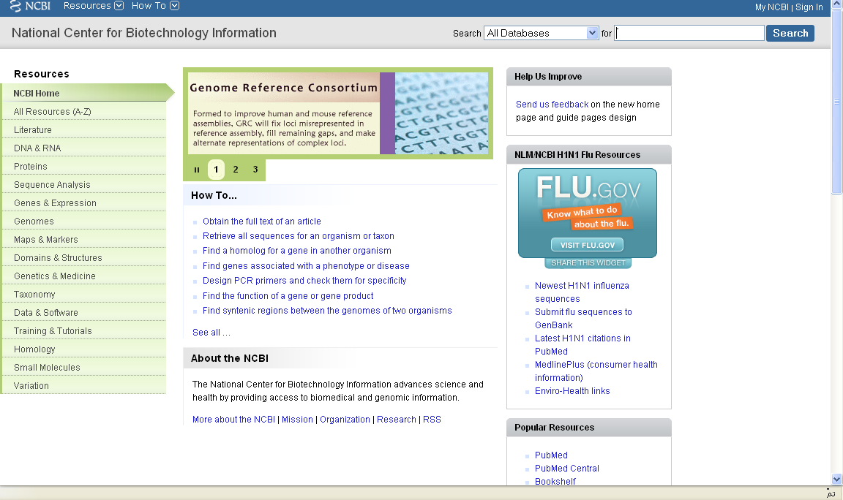
Select the type of query e.g. nucleotide sequence
Type your search query e.g. human actin gene

Slide 6
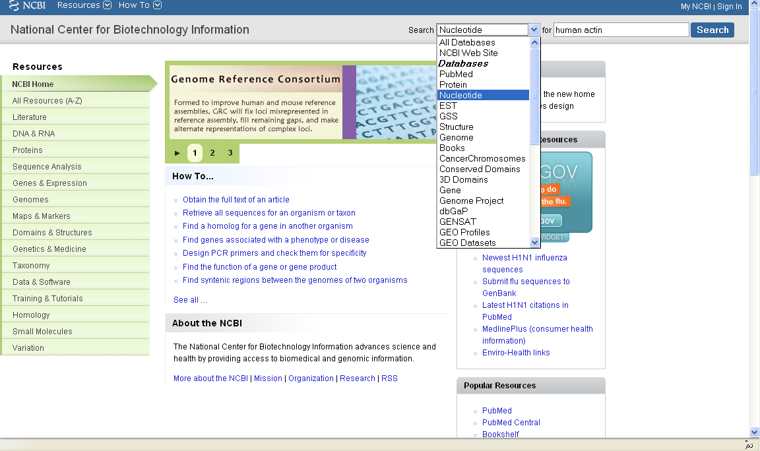

Slide 7
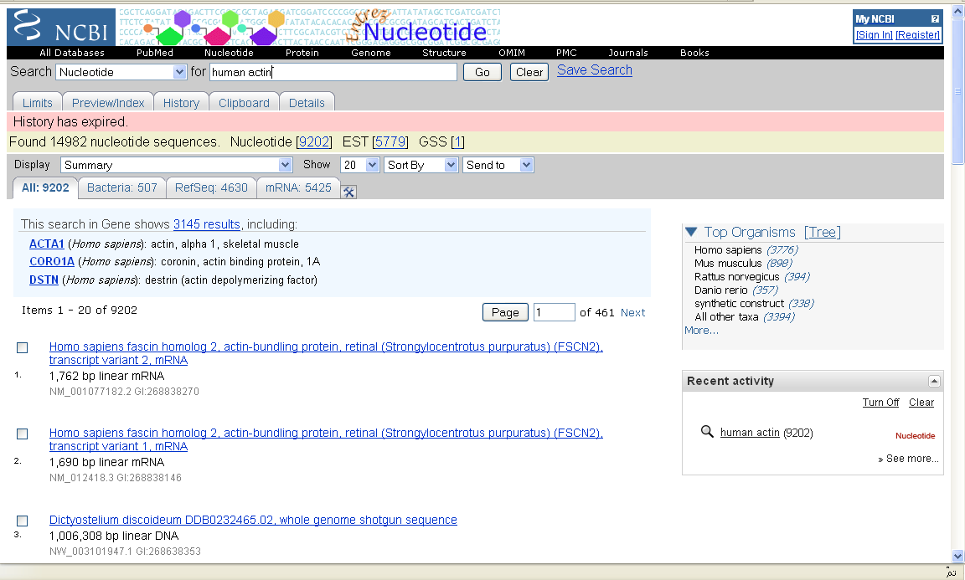
Look for what you want

Slide 8
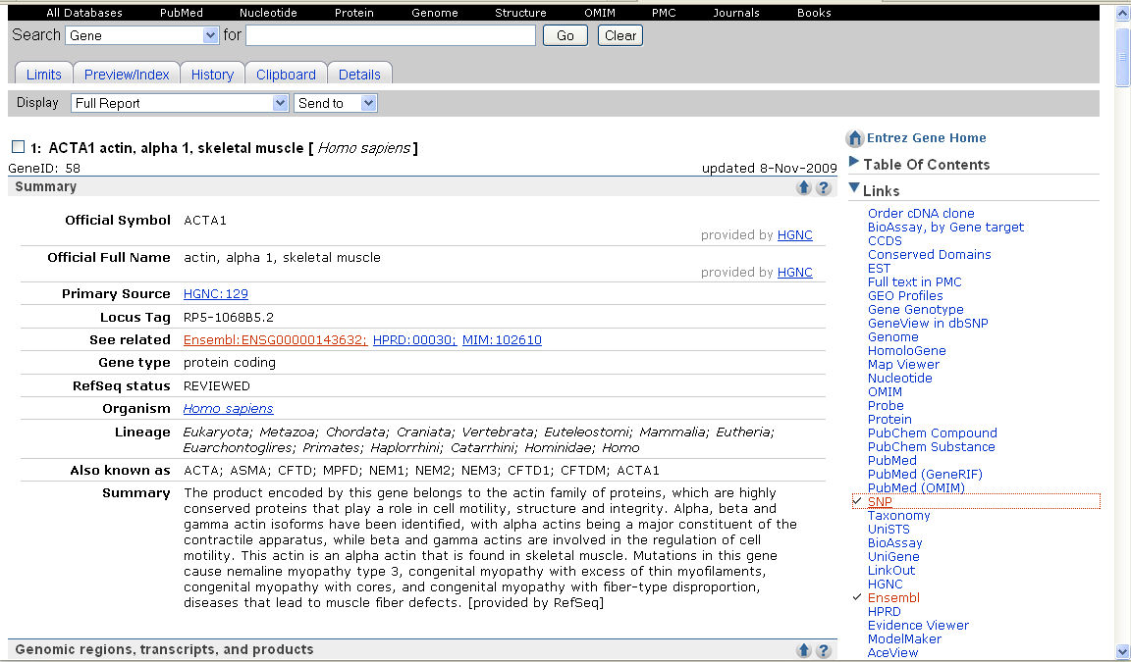
Retrieve your sequence from GENEBANK or ENSEMBLE
Find your sequence in ENSEMBLE

Slide 9
Ensemble Genome Browser
Provides free access to sequence data from 12 organisms, including the human genome sequence and data from all the most important, commonly used experimental organisms.
It shows the location of genes, variations and other sequence features within genomes, and allows comparisons to be made between organisms.

Slide 10
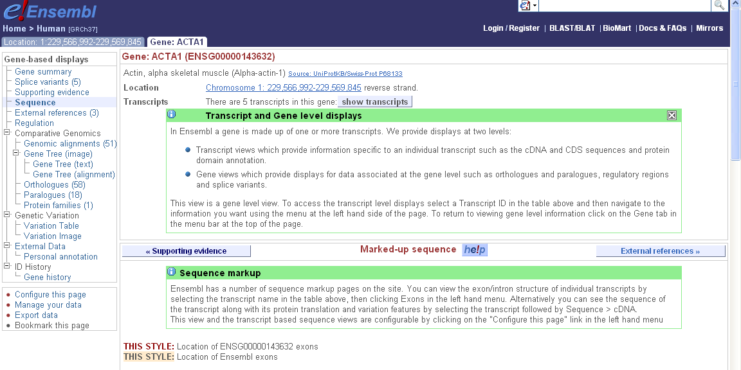
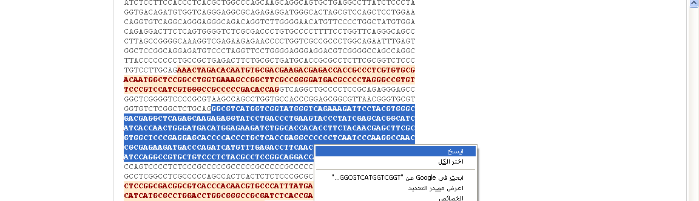
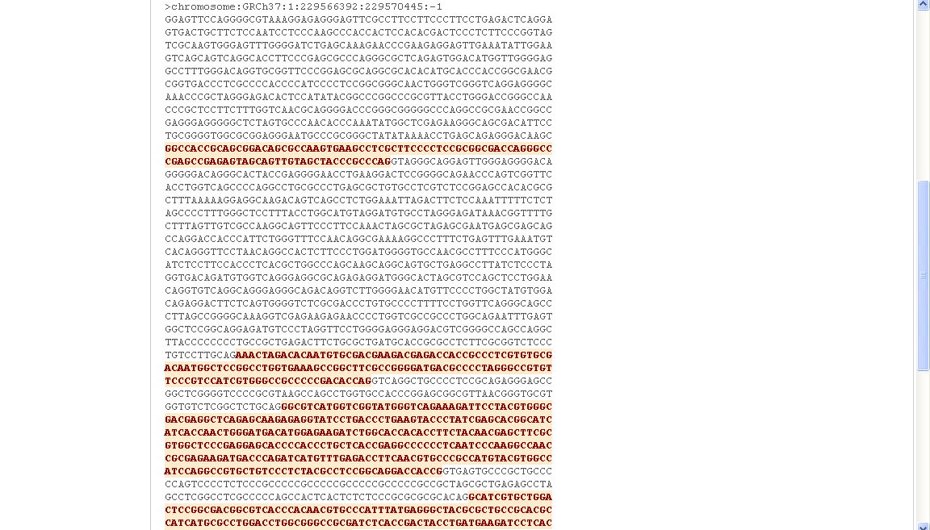
Intron
Exon
Intron
Exon
Intron
Exon
Intron
Exon
Intron

Slide 11
Primer3
PCR primers design software.

Slide 12
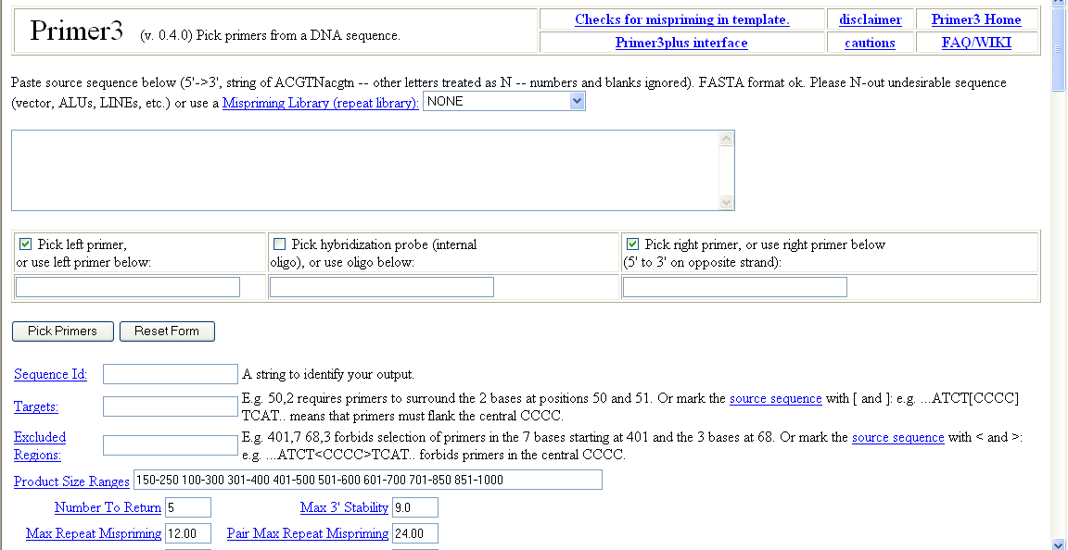
Primer3
The primer design web-based software
Paste your sequence here

Slide 13
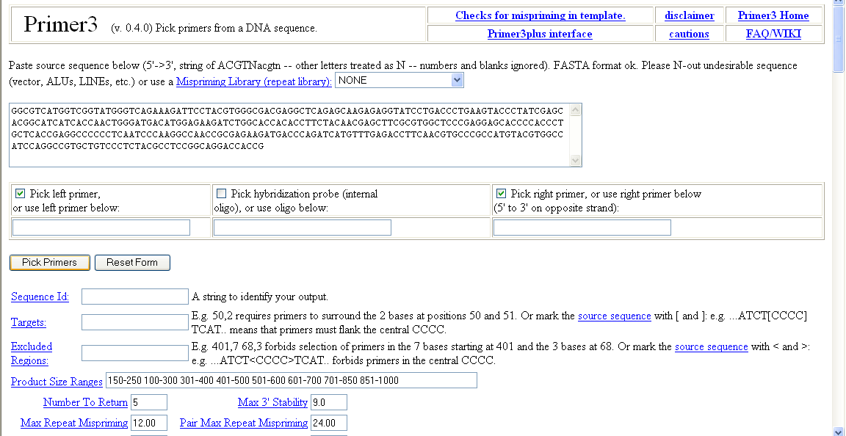
Primer3
The primer design web-based software

Slide 14
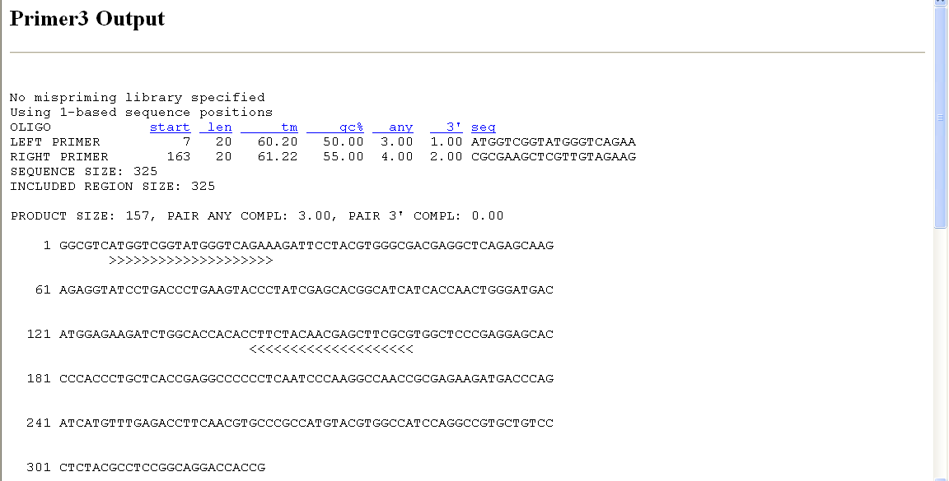
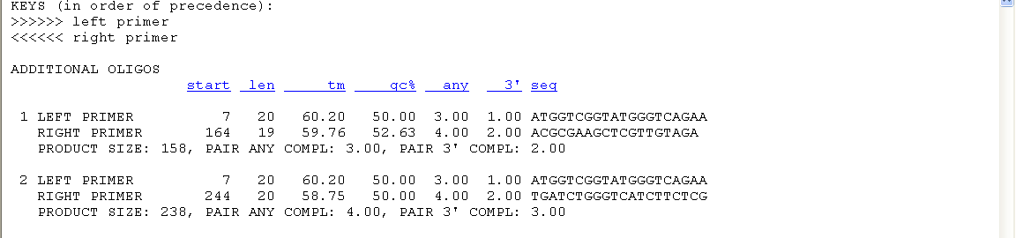
Wait !!!!
You have to check your primers

Slide 15
UCSC In-Silico PCR
Electronic PCR

Slide 16
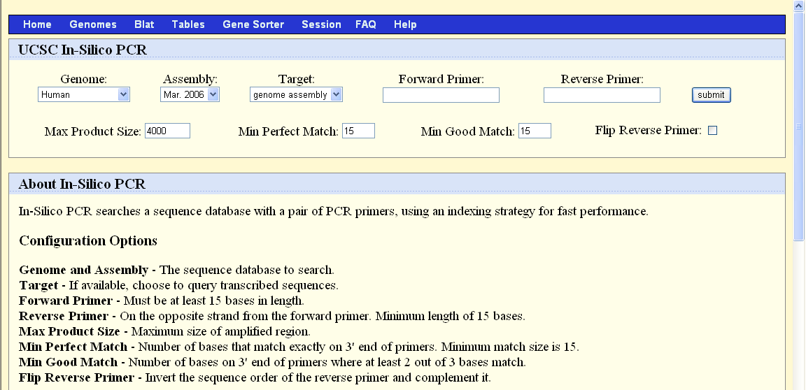
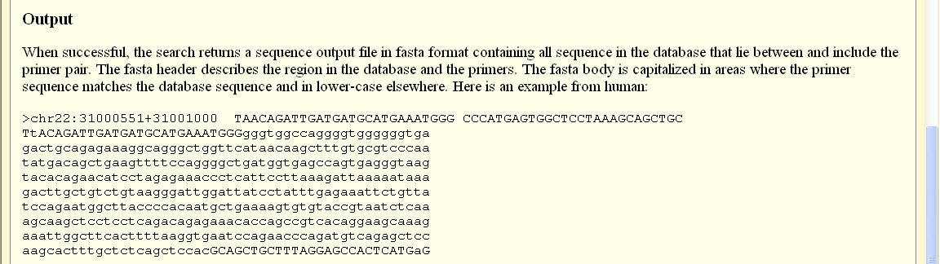
Paste your forward & reverse primers here

Slide 17
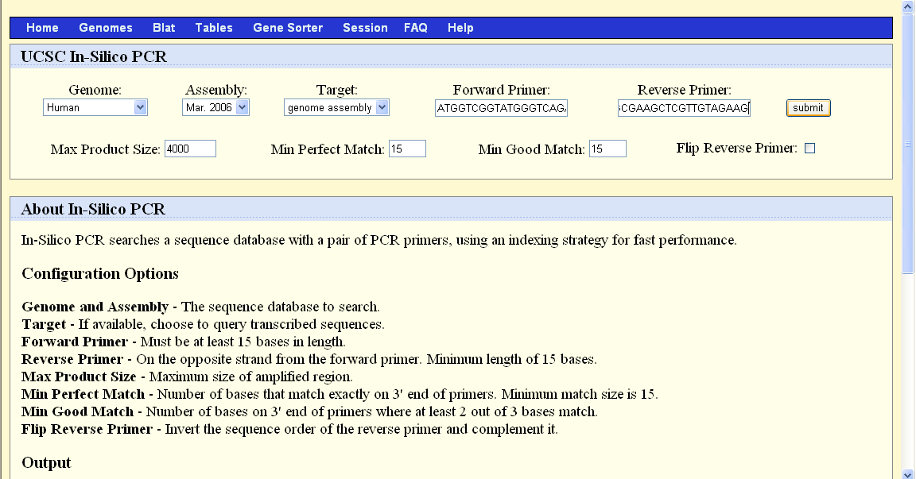

Slide 18
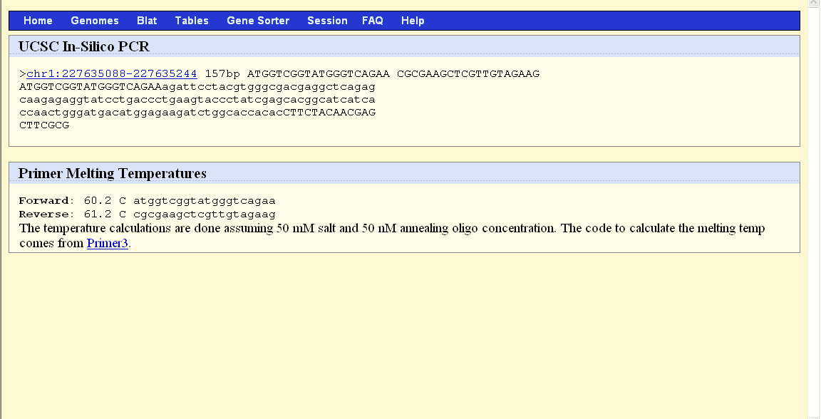
PCR product size
Forward primer
Reveres primer
Congratulations !!!!
Your primers are working

Slide 19
How To Genotype SNP by RFLP

Slide 20
Find your SNP

Slide 21
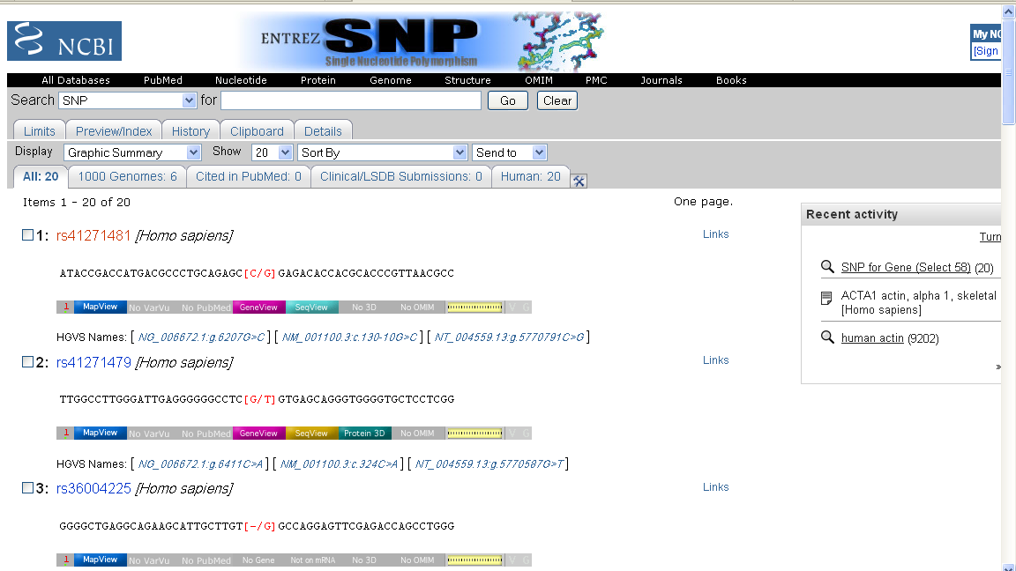
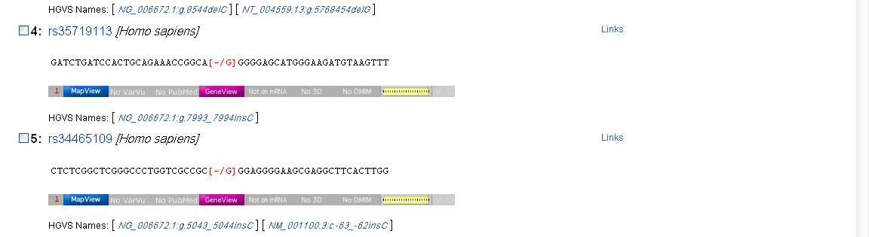

Slide 22
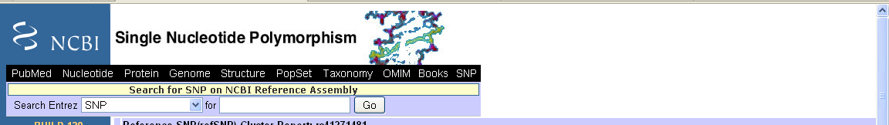
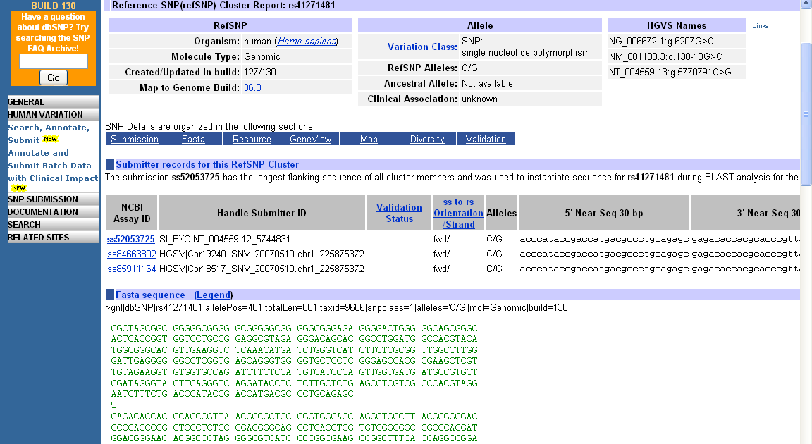
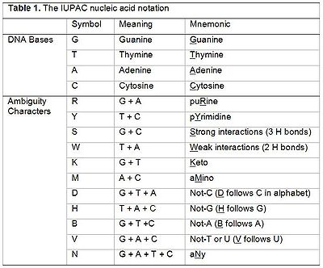
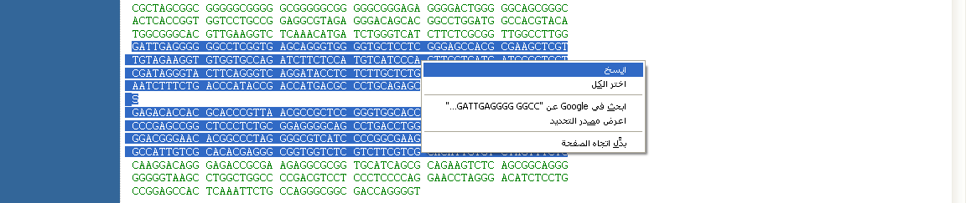
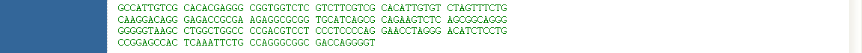
Allelic variation
Retrieve the sequence containing your SNP

Slide 23
Nucleotides IUPAC

Slide 24
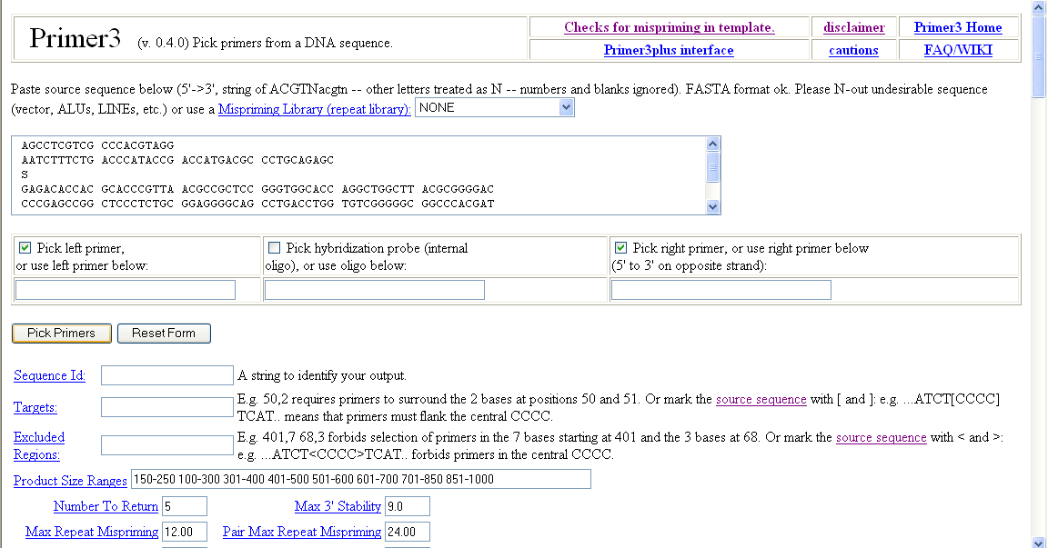
Primer3
The primer design web-based software

Slide 25
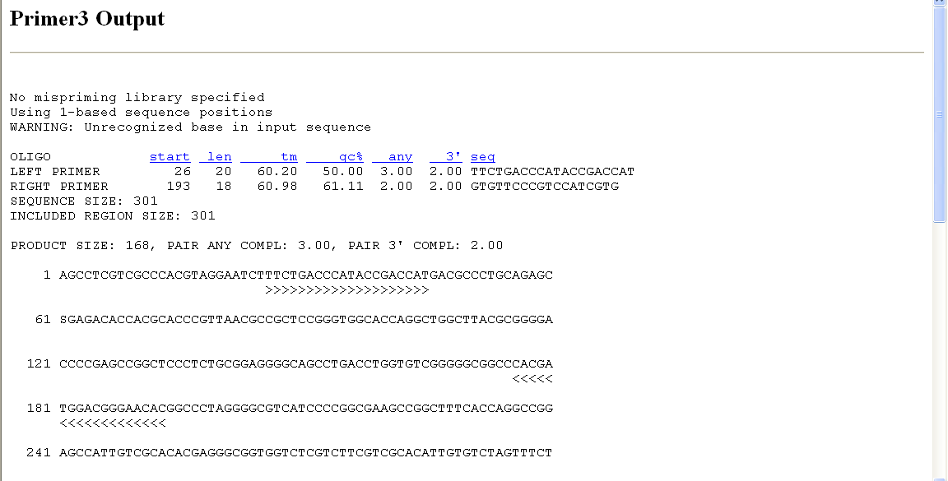
Your SNP (Position = 36)

Slide 27
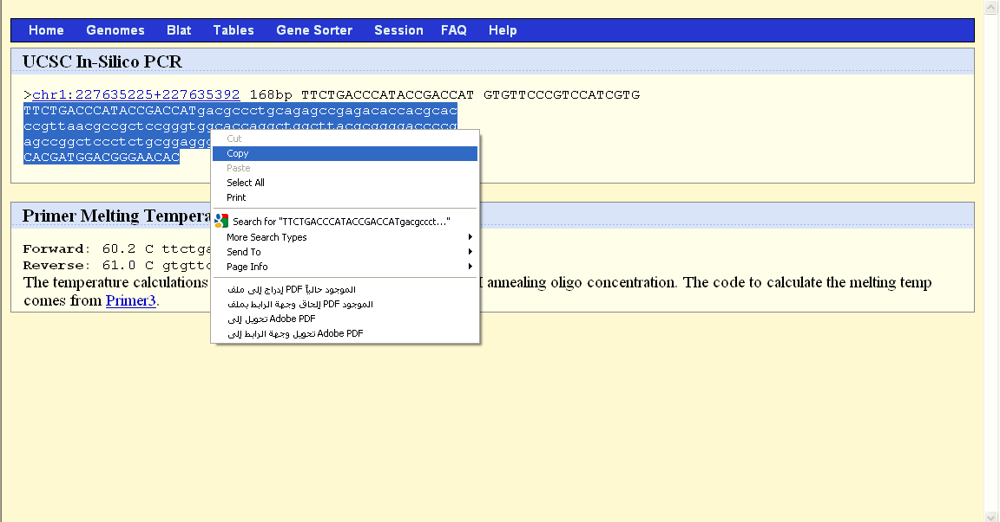
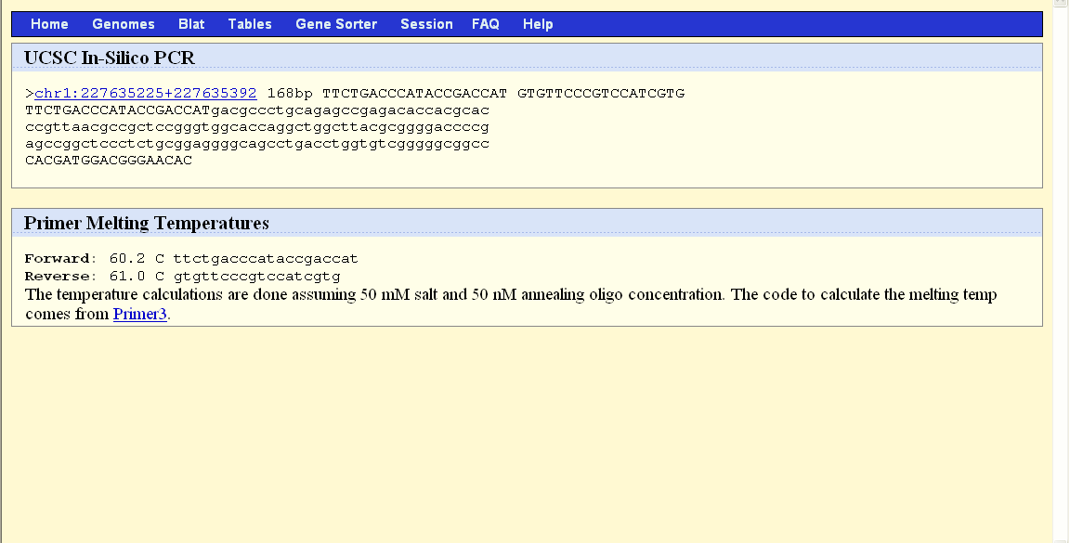
VERY IMPORTANT
You are copying the sequence of allele C

Slide 28
NEBCutter
Online free tool for determining the restriction enzymes that cut a particular DNA sequence; the sequence may be provided by the user as a text file, FASTA file, or GenBank number.

Slide 29
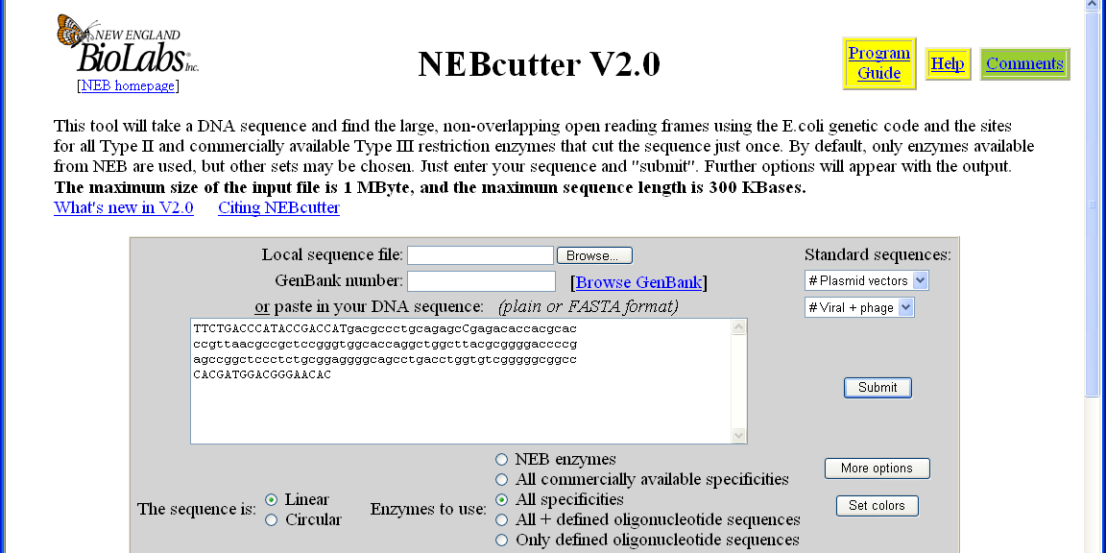
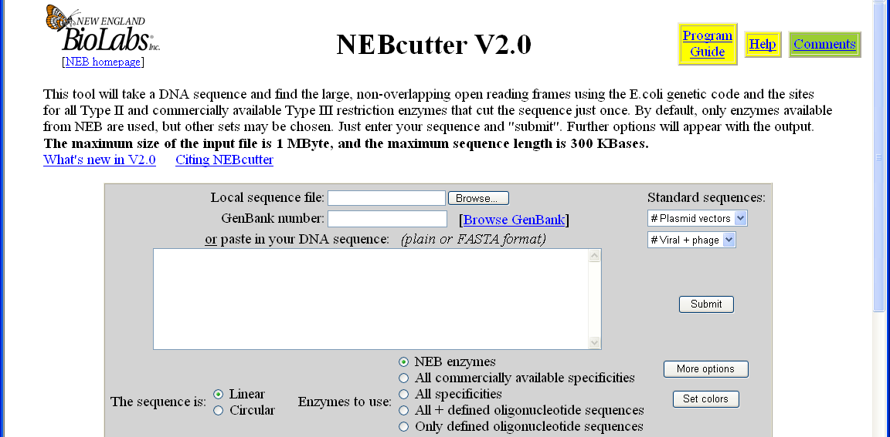
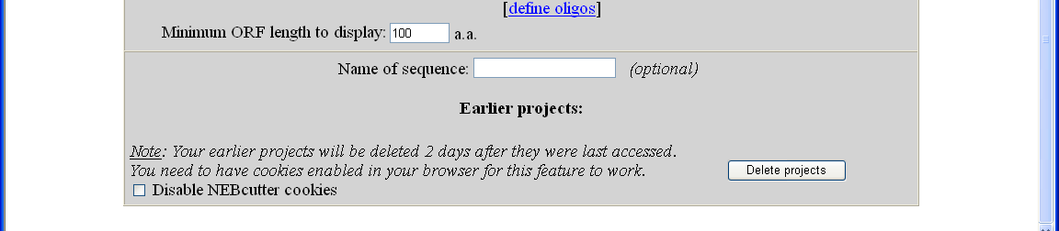
Your SNP (Allele C)

Slide 30
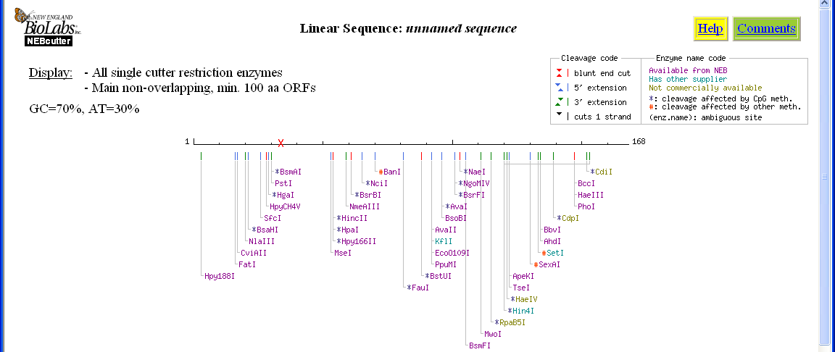
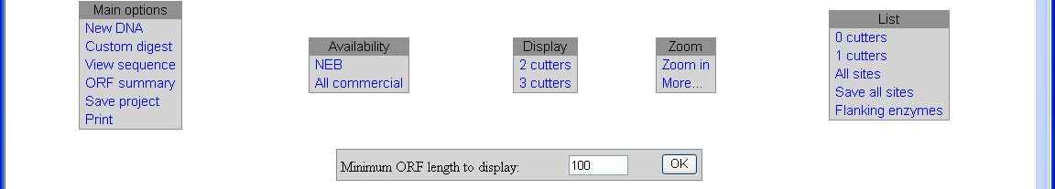
Mark the location of your SNP

Slide 31
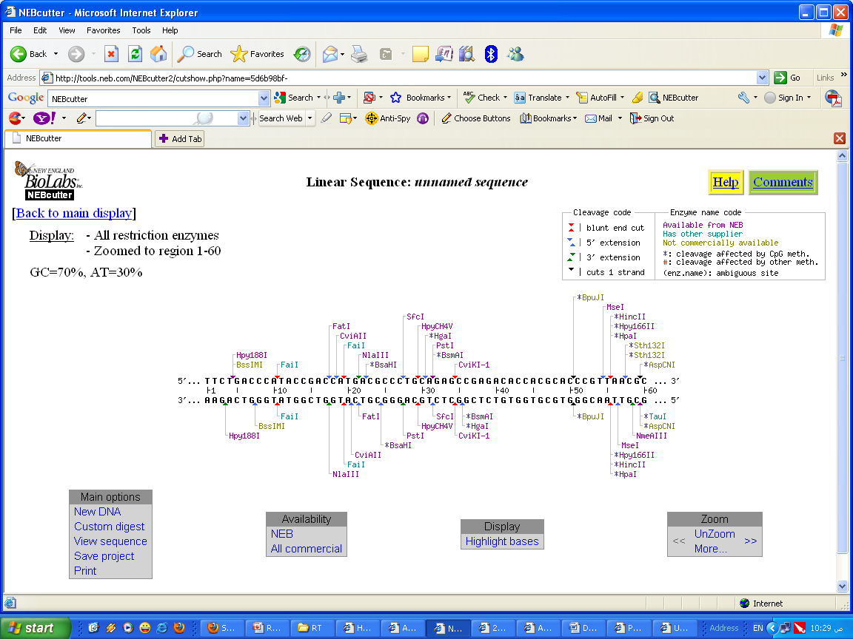
Your SNP (Allele C)

Slide 32

Your SNP (Allele G)

Slide 33
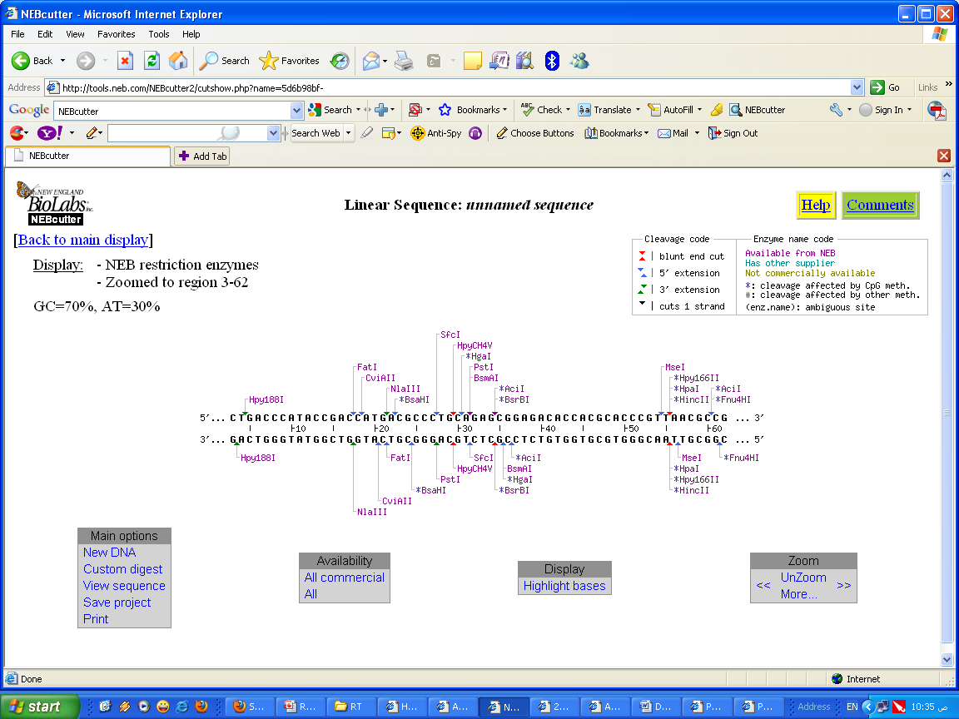
Your SNP (Allele G)

Slide 34
Your SNP (Allele G)
Your SNP (Allele C)

Slide 35
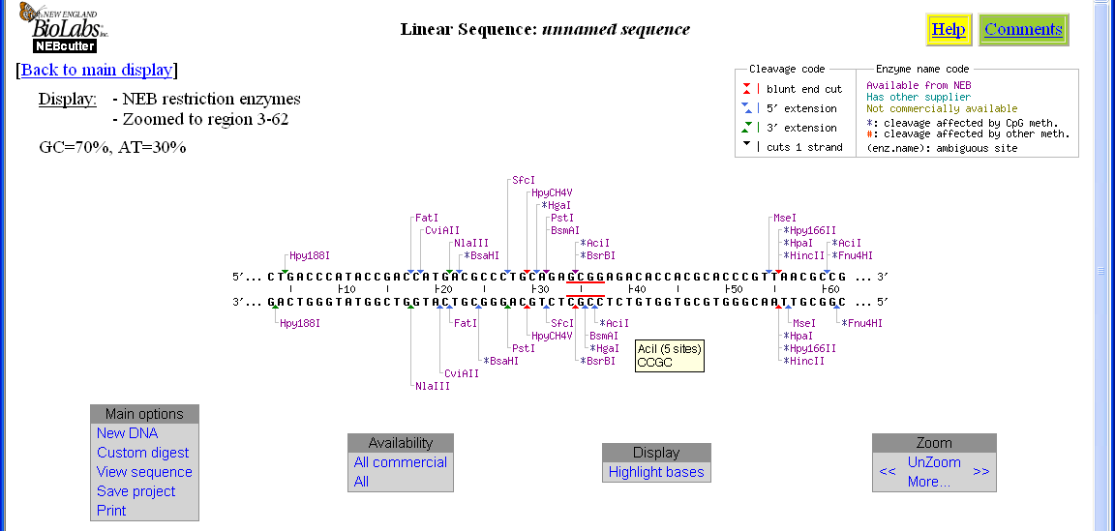

Slide 36
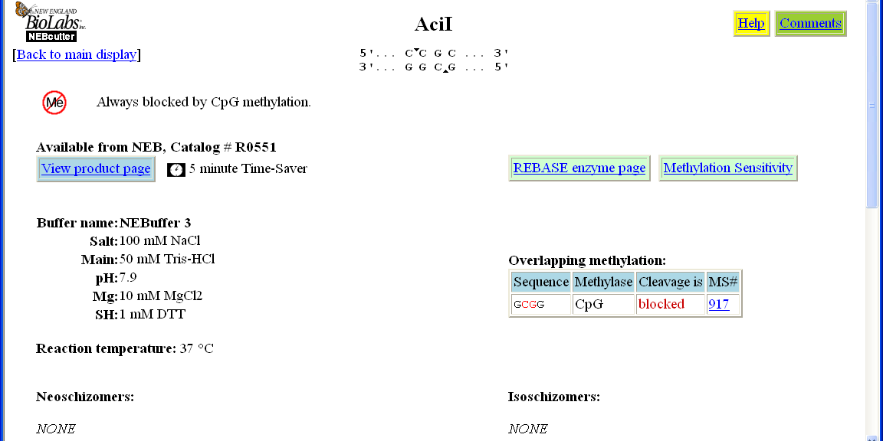
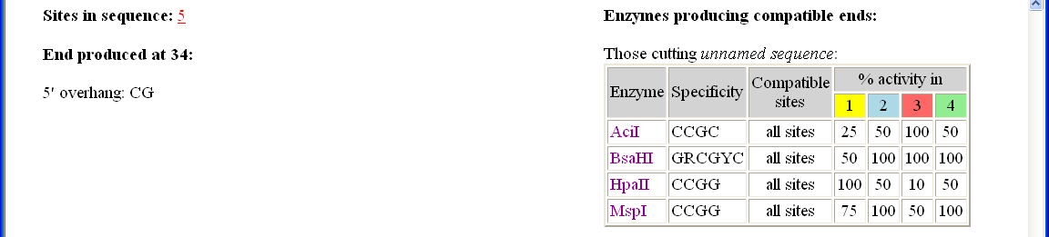

Slide 37
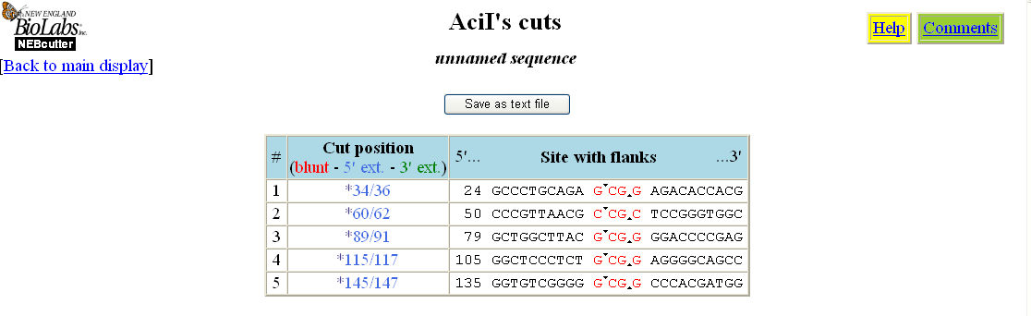
Band No. (Largest) | Genotype (G) | Genotype (C)
1 | 34 | 60
2 | 28 | 28
3 | 27 | 27
4 | 24 | 24

